Slide 1

A Secure Data Dynamics and Public Auditing Scheme for Cloud Storage
SRM INSTITUTE OF SCIENCE AND TECHNOLOGY
COLLEGE OF ENGINEERING AND TECHNOLOGY
DEPARTMENT OF NETWORKING AND COMMUNICATIONS
18CSP107L - MINOR PROJECT
RA2011028010069 - D.BHARGAV
RA2011028010083 - UPANSHU BHARDWAJ
Batch ID:NWC038
Guide name and Designation:
Dr.Saravanan M- Academic Advisor, NWC

Slide 2
Table of Contents
Abstract
Introduction
Problem Statement
Objectives
Literature Review
UML Diagrams-ER diagrams/Use case diagram/Activity
Modules
Algorithms in each module
Conclusion
References

Slide 3
Abstract
Cloud computing is an evolving technology that provides data storage and highly fast computing services at a very low cost
All data stored in the cloud is handled by their cloud service providers or the caretaker of the cloud. The data owner is concerned about the authenticity and reliability of the data stored in the cloud as the data owners.
Data can be misappropriated or altered by any unauthorized user or person
Our solution is to provide a secure public auditing scheme applying third party auditors to authenticate the privacy, reliability, and integrity of data stored in the cloud
This proposed auditing scheme composes the use of the AES-256 algorithm for encryption, SHA-512 for integrity check and RSA-15360 for public key encryption.
And also perform data dynamics operation which deals with mostly insertion, deletion, and, modification.

Slide 4
Introduction
Welcome to Secure Cloud Storage, a trust and understand between Data owner and the Service Provider
The global cloud computing market is anticipated to rise from $272billion in 2018 to $624billion by 2023 at a compound annual growth rate of 18%, a report from research and markets showed.
However, with the migration of sensitive and critical data to remote cloud servers, ensuring the security, integrity, and privacy of this data has become a paramount concern
Users need robust mechanisms to verify that their data is stored correctly and securely, especially when entrusting third-party cloud service providers with their valuable information.

Slide 5
In response to these concerns, the project "A Secure Data Dynamic and Public Auditing Scheme for Cloud Storage" aims to develop an innovative and comprehensive auditing scheme tailored to the cloud storage environment
This scheme will address several key challenges faced by both cloud service providers and users, offering a win-win solution that enhances data security while ensuring transparency and accountability.

Slide 6
Problem Statement
As the adoption of cloud storage solutions continues to grow, ensuring the security, integrity, and privacy of data stored in the cloud has become a critical concern for both individual users and organizations.
The Cloud service providers offer convenient and cost-effective storage options, but users must trust these providers to safeguard their data properly
The primary challenge in cloud storage is verifying the integrity of data and ensuring that it remains secure throughout its lifecycle. This challenge becomes even more complex in dynamic environments where data is subject to frequent updates, deletions, and additions.
To address these issues, this project aims to develop a comprehensive and innovative auditing scheme specifically designed for cloud storage environments

Slide 7
Objectives
The objective of this project is to develop a robust and efficient data dynamics and public auditing scheme for cloud storage.
The scheme aims to ensure the security and integrity of data in the cloud, while also allowing authorized users to dynamically modify the stored data.
Additionally, the project seeks to enable public auditing, allowing third-party auditors to verify data integrity without accessing the actual content
By achieving these objectives, the proposed scheme enhances the trustworthiness and accessibility of cloud storage services, addressing crucial concerns regarding data privacy and security in cloud computing environments.

Slide 8
Literature Review
S NO | TITLE OF THE PAPER | PUBLISH YEAR | AUTHOR | ISSUES ADDRESSED | TOOLS& LANGUAGES USED
1 | Secure Cloud Storage with Deduplication Technique 2020 | 2021 | R. Patil Rashmi; Yatin Gandhi; Vinaya Sarmalkar | Deduplication on client side cannot be given a new hash tag when updation of file is done. Hence, dynamic ownership fails | homomorphic hash algorithm, RDPC protocol, C++,
2 | Secured File Storage in Cloud Computing Application: Secure-Drive 2021 | 2021 | Nidhi Nair; Tanuj Jain; Mihir Gada | Secure Transmission Protecting files during upload and download by using secure communication protocols like HTTPS and ensuring data remains confidential during transit. | Html, Css, Blowfish and TripleDES, Phyton .
3 | TPA Auditing to Enhance the Privacy and Security in Cloud Systems | 2020 | Sunil Kumar, Dilip Kumar, Hemraj Lamkuche | More cost , Time taking process.It need future development to reach the public auditing. | CSL and BLAKE3 hash algorithm,C++ Amazon S3,

Slide 9
Literature Review
S NO | TITLE OF THE PAPER | PUBLISHED YEAR | AUTHOR | ISSUES ADDRESSED | TOOLS& LANGUAGES USED
4 | A Real Time Auditing System using QR Code for Secure Cloud Storage 2020 | 2020 | P. Baby Shamini; D. C. Joy Winnie Wise; K. S. Megavarshini. | Concurrency Control ,Mobile Device Considerations. | HTML , CSS ,Python , Apache MariaDB
5 | A Design for Scalable and Secure Key-Value Stores. | 2017 | Longbin Chen; Wenyun Dai. | As querying language is not present in key-value databases, transportation of queries from one database to a different database cannot be done | flash memories, Python,Amazon Dynamo and Google BigTable.
6 | Orchini Similarity User Authentication Based Streebog Hash Function for Secured Data Storage in Cloud | 2020 | P. Calista Bebe, Akila D. | High implementaton cost, If the number of owners increases it maximize the computation time | Amazon EC2 dataset, OSA-SHSDS

Slide 10
Literature Review
S NO | TITLE OF THE PAPER | PUBLISHED YEAR | AUTHOR | ISSUES ADDRESSED | TOOLS& LANGUAGES USED
7 | An efficient auditing scheme for data storage security in cloud | 2017 | J Agarkhed, R Ashalatha | In this paper, we propose an efficient auditing system for fog-to-cloud computing. Although our system is not public auditing
8 | Third Party Public Auditing on Cloud Storage using the Cryptographic Algorithm | 2017 | B.L Adokshaja, and S.J.Saritha | An efficient and securable privacy preserving public auditing scheme is been proposed. It achieves privacy preserving and public auditing The data is split into parts and then stored in the in the cloud storage
9 | Cloud Server Storage Security using TPA | 2014 | IK Meenakshi and Sudha George | The process such as the data owner can check the integrity of their data stored in cloud server using TPA which can be done inefficient manner

Slide 11
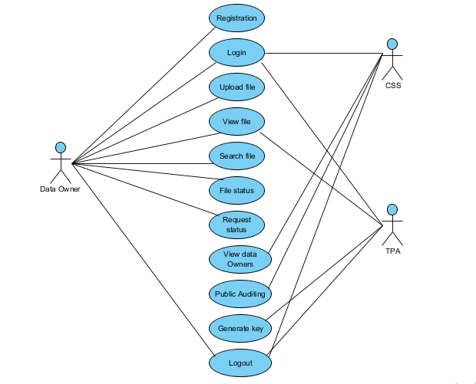
Use case diagram

Slide 12
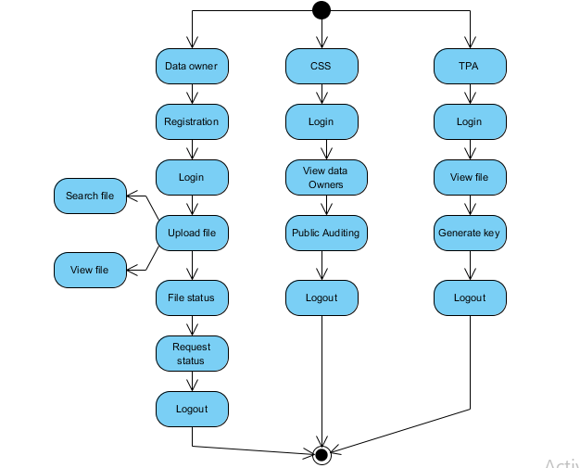
Activity Diagram

Slide 13
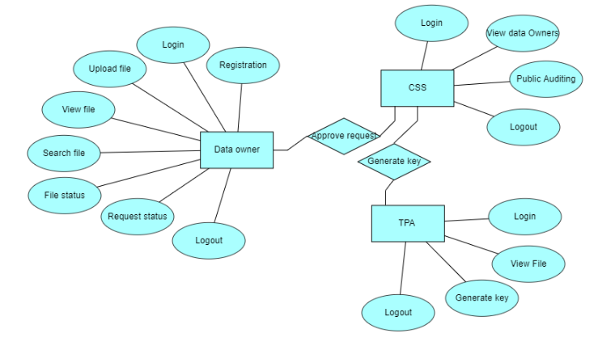
ER Diagram

Slide 14
Modules
User Authentication and Access Control Module:
This module manages user authentication and authorization to ensure that only authorized users can access and modify data in the cloud storage system.
Data Encryption Module:
Data encryption is essential to protect data confidentiality. This module encrypts data before it's stored in the cloud and decrypts it when retrieved.
Public Auditing Module:
The public auditing module allows third-party auditors to verify the integrity of the stored data without accessing the actual content.
Key Management Module:
Key management is crucial for encryption and decryption processes. This module generates, stores, and manages encryption keys securely.

Slide 15
Modules
Data Upload and Retrieval Module:
This module handles the uploading and retrieval of data by users. It ensures the secure transmission of data to and from the cloud.
Data Integrity Verification Module:
To maintain data integrity, this module computes and verifies cryptographic hashes or checksums to detect any unauthorized modifications.
Dynamic Data Operations Module:
This module enables users to perform dynamic operations on their data, such as insertions, deletions, and updates, while ensuring security and integrity.
Logging and Monitoring Module:
It records user activities and system events for auditing purposes and provides real-time monitoring capabilities for security and performance.
Compliance and Reporting Module:
This module generates compliance reports to demonstrate adherence to data protection and auditing regulations.

Slide 16
Algorithms
Data Encryption Algorithms:
AES (Advanced Encryption Standard):
AES is a widely adopted symmetric-key encryption algorithm used to encrypt data before it's stored in the cloud. It provides strong data confidentiality.
RSA (Rivest-Shamir-Adleman):
RSA is an asymmetric encryption algorithm often used for key exchange and digital signatures to secure communication channels and protect encryption keys.

Slide 17
Algorithms
Hashing Algorithms:
SHA-256 (Secure Hash Algorithm 256-bit):
SHA-256 is a cryptographic hashing algorithm used to compute checksums or hashes of data for verifying data integrity.
Signature Algorithms:
RSA Signature:
RSA signatures are used to verify the authenticity and integrity of data and to prove that data has not been tampered with during transfer.

Slide 18
Algorithms
Access Control and Authentication Algorithms:
Role-Based Access Control (RBAC):
RBAC is a model for access control where users are assigned roles with specific permissions. It ensures that users have the appropriate access rights.
Key Management Algorithms:
Key Derivation Functions (KDFs): KDFs are used to derive encryption keys from user passwords or other secrets, ensuring strong key management.
Resource Optimization Algorithms:
Load Balancing Algorithms:
Load balancing algorithms distribute incoming network traffic across multiple cloud resources to optimize resource utilization

Slide 19
Conclusion
A secure auditing method is to store the data on the cloud in a secure manner. The prospective take the AES-256 algorithm, RSA-15360, and SHA-512 algorithm to assure that TPA cannot knowledge about data toward the robustness auditing scheme. We propose a data dynamics operation with mostly deal insertion, deletion and, modification.
In conclusion, The secure data dynamic and public auditing scheme introduced in this research contributes to the ongoing efforts to create a safer and more trustworthy cloud storage environment, ultimately benefiting both cloud service providers and their users. TPA will give instance notification to the data owner if any modification occur in the data saved in the cloud, which builds trust between service provider and owner

Slide 20
References
The global cloud computing market report 2019.
J Agarkhed, R Ashalatha-”An efficient auditing schheme for data storage security in cloud”.2017[ICCPCT].
SK Saroj, G Noida,SK Chauhan, AK Sharma “Threshold cryptography based data security in cloud computing”. S Vats-2015.
Mell, Peter, and Tim Grance.The NIST definition of cloud computing(2011).
P.Mell and T.Grance, ”The NIST definition of cloud computing”, National Institute of Standards and Technology, Tech. Rep.,2009.

Slide 21
References
Swapnali Morea, Sangita Chaudhari, ”Third Party Public Auditing Scheme for Cloud Storage “,International Journal of Prpcedia Computer Science ,Volume 79,pp.69-76,2016.
Zissis, Dimitrios, and Dimitrios Lekkas. Addressing cloud computing security issues. Future Generation computer systems 28.3(2012):583-592.
B.L Adokshaja, and S.J.Saritha, ”Third Party Public Auditing on Cloud Storage using the Cryptographic Algorithm”ICECDS-2017.
Cong Wong, Sherman S M Chow, Qian Wang, Kui Ren, and Wen jing Lou. “Privacy Preserving Public Auditing for Secure Cloud Storage”. IEEE Transactions on Computers, Volume 62, ISSUE 2, February 2013

Slide 22
THANK YOU

